Slide 1



Mixture Hidden Markov models to detect engagement dynamics of mobile based Health program participants
S. Sandun Silva
Principal Supervisor : Professor Denny Meyer
Associate Supervisor : Dr Madawa W. Jayawardana
Industrial Supervision : Mr. Phil Hablish (General Manager at Virgin Pulse Global Challenge)
CRICOS 00111D TOID 3059

Slide 2
Outline
Background
Research Questions
Current Global Challenge
Detection of engagement dynamics
Hidden Markov Models
Mixture Hidden Markov Models
Application
Clusters Found
2

Slide 3
Background
Each year, for 100 days, hundreds of thousands of employees around the world compete in teams of seven as the Global Challenge (formerly the GCC) takes them on a journey that will improve both their physical and psychological health.
It is a scientifically developed, international 100-day program that improves the awareness of employees regarding their physical activity, nutrition, sleep and psychological wellbeing.
https://globalchallenge.virginpulse.com/program-overview.
The experience is brought to life with an award-winning website and smartphone apps, weekly personalized emails including overall performance, community message boards, live team leader boards, mini-challenges and trophies. Every member is taken on a journey of daily self-discovery, reward and achievement.
3

Slide 4

Current Global Challenge
Track quality and quantity of participant’s sleep and provide tips
Starts on 57th Day
Psychological wellbeing module which provides tips for a strong and balanced mindset
Starts on 43rd Day
Weight tracker –Allow to track weight and set up weight goals
Food calculator-Shows the average daily calorie intake
Starts on 22nd Day
Starts from the beginning
Track daily steps
Encourage users to achieve 10,000 steps
4

Slide 5
Detection of engagement dynamics
CRICOS 00111D TOID 3059
5

Slide 6
Hidden Markov Models
Hidden Markov Models are models in which the distribution that generates an observation depends on the state of an underlying and unobserved Markov process.
There are three basic question that needs to be answered to use this model in real world application.
Given the observational engagement sequence (O) and a HMM (λ), how to calculate Probability of observational engagement sequence, given the model [ P(O|λ) ] ?
Given the observational engagement sequence (O) and a HMM (λ), how to choose the corresponding state sequence (Q) which best explains the observational engagement sequence ?
How to adjust the model parameters (initial probabilities, transition probabilities and emission probabilities ) to maximize the P(O|λ)
Forward-Backward algorithm
Viterbi algorithm
Forward-Backward algorithm
CRICOS 00111D TOID 3059
6

Slide 7
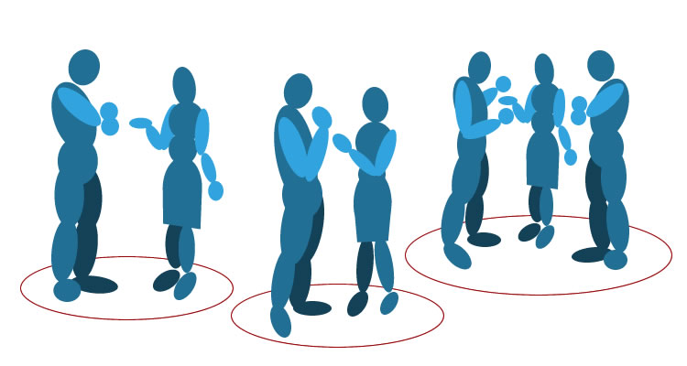
Hidden Markov Models
Hidden Markov Models are models in which the distribution that generates an observation depends on the state of an underlying and unobserved Markov process.
CRICOS 00111D TOID 3059
7

Slide 8

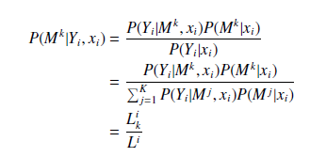
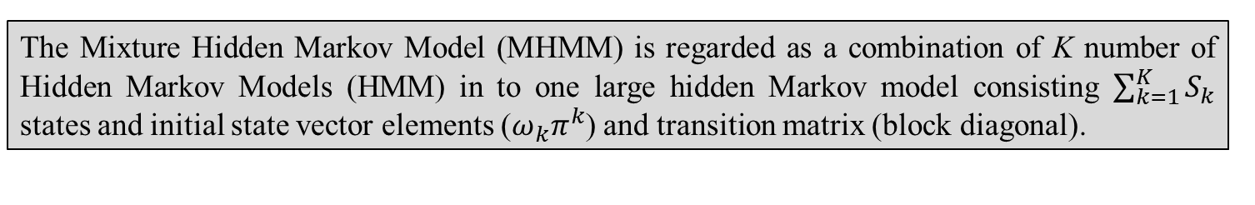
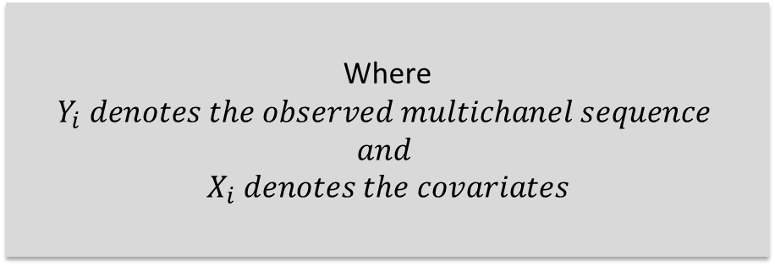
Mixture Hidden Markov Models
Hidden Markov Models
Hidden Markov Models are models in which the distribution that generates an observation depends on the state of an underlying and unobserved Markov process.
The Mixture Hidden Markov Model (MHMM) is regarded as a combination of K number of Hidden Markov Models (HMM) in to one large hidden Markov model consisting $\sum_{k=1}^{K}{S_{k}}$ states and initial state vector elements ($ω_{k}π^{k}$) and transition matrix (block diagonal).
(Van de Pol et al. 1990 & Helske et al., 2019)
Posterior Cluster Probabilities
Where $Y_{i} denotes the observed multichanel sequence$
$$and$$
$$X_{i} denotes the covariates$$
CRICOS 00111D TOID 3059
8

Slide 9
For physical activity module
Sequences Considered
Number of logins to the module per week :- (1 to 7 logins)
Number of entries for current week :- (0 to 7 entries)
Whether there is a Gap exist in engaged weeks :- (gap or no gap)
31 different MHMM models were tested by varying the number of clusters from two to four each with two to four hidden states
EM algorithm runs for 1000 iterations with 100 random restarts in order to reduce the risk of being trapped in poor local maximum.
Modelling MHMM
Model Selection
Bayesian Information Criteria (BIC) – Elbow method
Interpretability
9

Slide 10
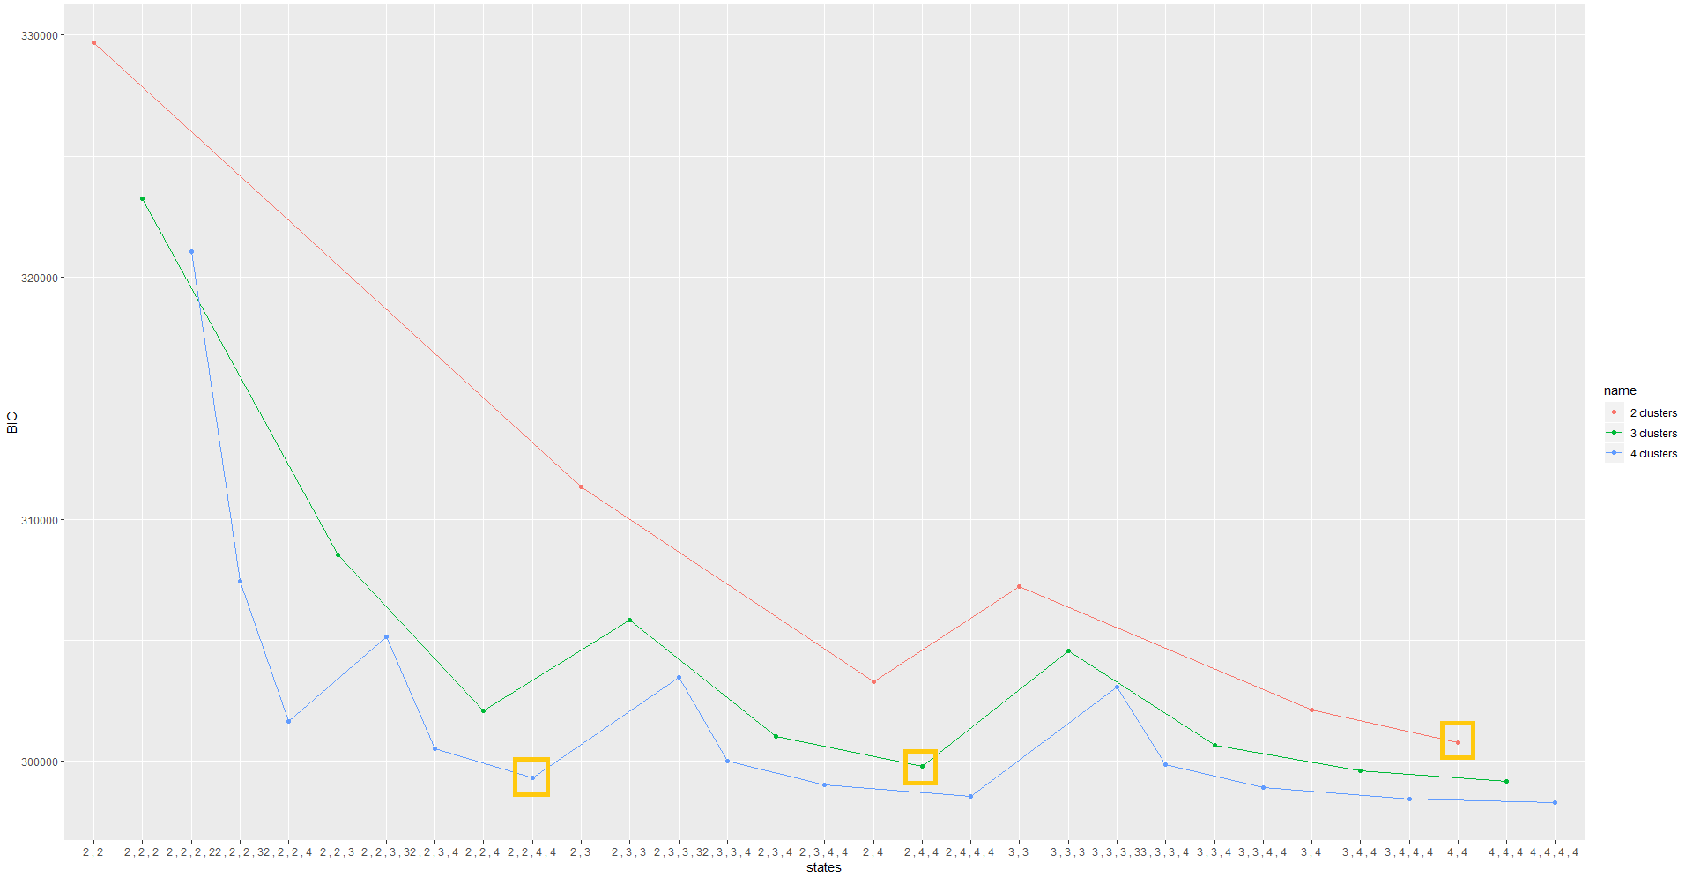
For physical activity module
Sequences Considered
Modelling MHMM
Model Selection
Number of logins to the module per week
Number of entries for current week
31 different MHMM models were tested by varying the number of clusters from two to four each with two to four hidden states
Bayesian Information Criteria (BIC) – Elbow method
Interpretability
Expectation Maximisation (EM) algorithm runs for 1000 iterations with 100 random restarts in order to reduce the risk of being trapped in poor local maximum.
10

Slide 11

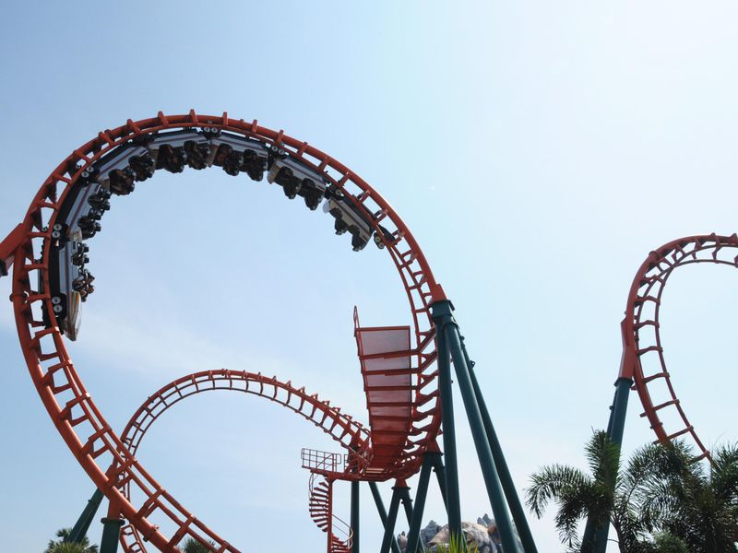

Best MHMM obtained
Obtained 3 clusters
Stable Engagers
2 hidden states
Volatile Engagers
4 hidden states
Low level Engagers
4 hidden states
11

Slide 12
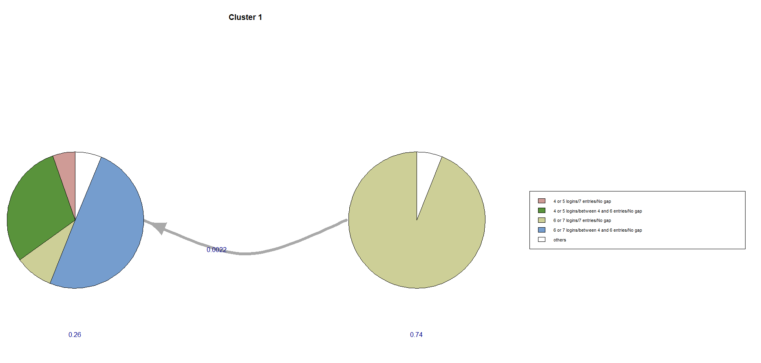
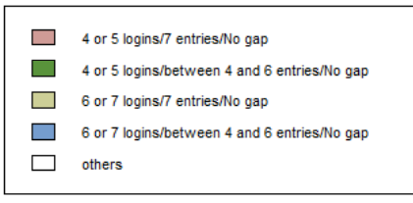
Stable Engagers
Name of the cluster | Number of participants | Proportion of participants | Hidden state | Number of logins | Number of entries | Gap | Hidden state sequence
Stable engagers | 226 | 4.50% | More Frequent engaging state | 6 or 7 logins/4 or 5 logins | between 4 and 6 entries | No Gap | Perfect engagers -> More Frequent engagers
 |  |  | Perfect engagers | 6 or 7 logins | 7 entries | No Gap
0
More Frequent engaging state
Perfect engagers
12

Slide 13
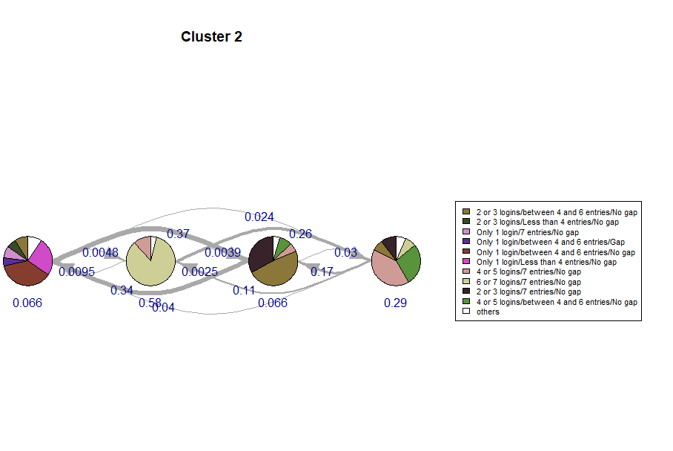
Volatile Engagers
Name of the cluster | Number of participants | Proportion of participants | Hidden state | Number of logins | Number of entries | Gap | Hidden state sequence
Volatile engagers | 2144 | 42.90% | Tend to be Repellant engaging state | Only 1 login | between 4 and 6 entries/ Less than 4 entries | No Gap | Perfect engagers ->Less frequent engaging state -> Tend to be Repellant engaging state <--> Lazy engaging state
 |  |  | Perfect engagers | 6 or 7 logins | 7 entries | No Gap
 |  |  | Lazy engaging state | 2 or 3 logins | between 4 and 6 entries/ 7 entries | No Gap
 |  |  | Less frequent engaging state | 4 or 5 logins/ 2 or 3 logins | 7 entries/ between 4 and 6 entries | No Gap
Tend to be Repellant engaging state
Perfect engagers
Lazy engaging state
Less frequent engaging state
13

Slide 14
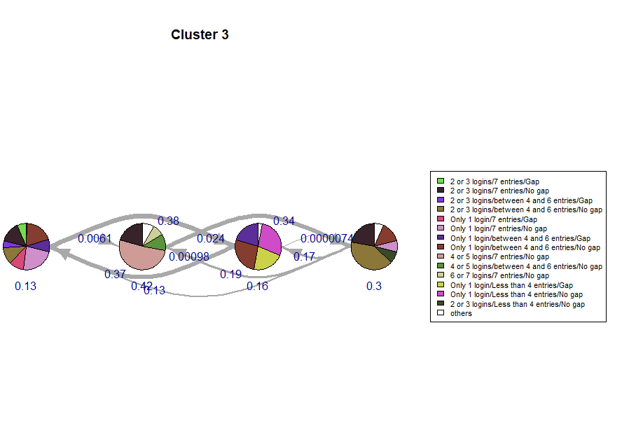
Low level Engagers
Name of the cluster | Number of participants | Proportion of participants | Hidden state | Number of logins | Number of entries | Gap | Hidden state sequence
Low level engagers | 2630 | 52.60% | Lower Repellent engaging state | Only 1 login/2 or 3 logins | 7 entries/between 4 and 6 entries | No Gap/Gap | Less frequent engaging state -> Lazy engaging state -> Lower Repellant engaging state <--> Higher Repellant engaging state
 |  |  | Less frequent engaging state | 4 or 5 logins/ 2 or 3 logins | 7 entries | No Gap
 |  |  | Higher Repellent engaging state | Only 1 login | Less than 4 entries/ between 4 and 6 entries | No Gap/Gap
 |  |  | Lazy engaging state | 2 or 3 logins/ Only 1 login | between 4 and 6 entries/ 7 entries | No Gap
Lower Repellent engaging state
Less frequent engaging state
Higher Repellent engaging state
Lazy engaging state
14

Slide 15
Summary of Progress
Completed a systematic review on “statistical models used to model and evaluate physical activity programs, using step counts” and published.
Contributed for another related systematic review on “Predictors of engagement and health behavior change in workplace health and exercise programs targeting physical activity” and selected for publication.
Ethics approval for the following project (SHR Project 2018/076) has been obtained on April 2018.
Completion of Outlier and Cheater detection- R shiny application (TAAD)
Modelling engagement dynamics of the “physical activity” module.
15

Slide 16
References
Scherer, E. A., Ben-Zeev, D., Li, Z., & Kane, J. M. (2017). Analyzing mHealth Engagement: Joint Models for Intensively Collected User Engagement Data. JMIR mHealth and uHealth, 5(1). doi:10.2196/mhealth.6474
Satu Helske and Jouni Helske. Mixture hidden Markov models for sequence data:
The seqHMM package in R. Journal of Statistical Software, 88(3):1–32, 2019.
Vandelanotte, C., Short, C., Plotnikoff, R. C., Hooker, C., Canoy, D., Rebar, A., Alley, S., Schoeppe, S., Mummery, W. K., & Duncan, M. J. (2015). TaylorActive--Examining the effectiveness of web-based personally-tailored videos to increase physical activity: a randomised controlled trial protocol. BMC Public Health, 15, 1020. doi:10.1186/s12889-015-2363-4
Van Den Broek, J. (1995). A Score Test for Zero Inflation in a Poisson Distribution. Biometrics, 51(2), 738-743. doi:10.2307/2532959
Wang, X., Smith, K., & Hyndman, R. (2006). Characteristic-Based Clustering for Time Series Data. Data Mining and Knowledge Discovery, 13(3), 335-364. doi:10.1007/s10618-005-0039-x
16

Slide 17

17

